Slide 1
SECURE DATA HIDING IN IMAGES USING STEGANOGRAPHY
CAPSTONE PROJECT
Presented By : Ritu Koley
Student Name : Ritu Koley
College Name : St. Thomas’ College of Engineering and Technology
Department : Information Technology

Slide 2
OUTLINE
Problem Statement
Technology used
Wow factor
End users
Result
Conclusion
Git-hub Link
Future scope

Slide 3
Problem Statement
The program implements image-based stenography using OpenCV.
It embeds a secret message into an image by modifying pixel values and stores encryption details in a separate file.
Decryption is performed by retrieving the message from the image using the stored password and message length.
If the correct password is provided, the hidden message is revealed; otherwise, access is denied.

Slide 4
Technology used
Programming Language: Python
Libraries:
OpenCV (cv2) – For image processing and pixel manipulation
OS – For file handling and system operations
Platform: Windows
IDE/Editor: VS Code (Visual Studio Code)
File Handling: Uses .txt files for storing encryption details
Image Format: Works with .png

Slide 5
Wow factors
Unique Features:
Steganography with Image Pixels – Hides a secret message inside an image by modifying pixel values.
Password-Protected Decryption – Ensures security by requiring the correct password to access the message.
Lightweight & Fast – Efficient encryption and decryption without heavy processing.
No Database Required – Stores encryption details in a simple text file.
Cross-Compatible & Customizable – Works with multiple image formats and can be modified for enhanced security.

Slide 6
End users
Who are the end users?
Cybersecurity Enthusiasts – Those interested in encryption and data hiding techniques.
Journalists & Whistleblowers – For securely transmitting confidential information.
Forensic Experts – Useful in digital forensics and secure communication.
Developers & Researchers – To learn and experiment with image-based steganography.
General Users – Anyone who wants to send hidden messages securely within images.

Slide 7
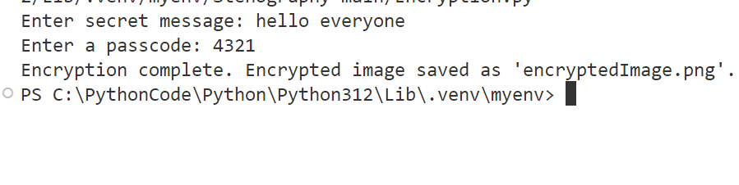
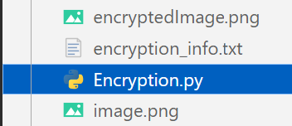
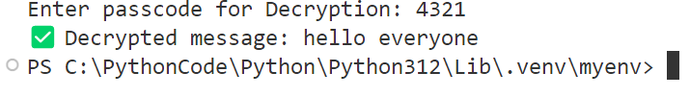
Results
Screenshots of the outcome (min 3)
Encryption.py Saved Image and password_length
Decryption.py

Slide 8
Conclusion
This project provides a simple and efficient way to hide messages within an image using steganography. With password-protected decryption, it ensures secure message retrieval. The lightweight design, ease of use, and lack of a database make it a practical solution for secure communication.

Slide 9
GitHub Link
https://github.com/RituKoley/Steganography-Project.git

Slide 10
Future scope(optional)
Enhanced Security: Implement advanced encryption and multi-layer steganography.
Larger Message Support: Optimize for longer messages and use compression techniques.
Cross-Platform Support: Ensure compatibility across all major OS and mobile devices.
GUI Interface: Create a user-friendly graphical interface for easy interaction.
Detection Tool: Develop a tool to detect hidden messages in images.
Video Steganography: Expand to hide messages in video files by modifying frames.

Slide 11
THANK YOU

